Slide 1
Design Engineering based on
Chapter 9 Software Engineering: A Practitioner’s Approach, 6/e copyright © 1996, 2001, 2005
R.S. Pressman & Associates, Inc.
For University Use Only
May be reproduced ONLY for student use at the university level when used in conjunction with Software Engineering: A Practitioner's Approach.
Any other reproduction or use is expressly prohibited.
These courseware materials are to be used in conjunction with Software Engineering: A Practitioner’s Approach, 6/e and are provided with permission by R.S. Pressman & Associates, Inc., copyright © 1996, 2001, 2005

Slide 2

Analysis Model -> Design Model
These courseware materials are to be used in conjunction with Software Engineering: A Practitioner’s Approach, 6/e and are provided with permission by R.S. Pressman & Associates, Inc., copyright © 1996, 2001, 2005

Slide 3
Design and Quality
the design must implement all of the explicit requirements contained in the analysis model,
… and it must accommodate all of the implicit requirements desired by the customer(?)
the design must be a readable, understandable guide for those who generate code and for those who test and subsequently support the software.
the design should provide a complete picture of the software, addressing the data, functional, and behavioral domains from an implementation perspective.
These courseware materials are to be used in conjunction with Software Engineering: A Practitioner’s Approach, 6/e and are provided with permission by R.S. Pressman & Associates, Inc., copyright © 1996, 2001, 2005

Slide 4
Quality Guidelines
A design should exhibit an architecture that
  (1) has been created using recognizable architectural styles or patterns, (2) is composed of components that exhibit good design characteristics (3) can be implemented in an evolutionary fashion
A design should be modular; that is, the software should be logically partitioned into elements or subsystems
A design should contain distinct representations of data, architecture, interfaces, and components.
A design should lead to components that exhibit independent functional characteristics.
A design should be represented using a notation that effectively communicates its meaning.
These courseware materials are to be used in conjunction with Software Engineering: A Practitioner’s Approach, 6/e and are provided with permission by R.S. Pressman & Associates, Inc., copyright © 1996, 2001, 2005

Slide 5
Fundamental Concepts
abstraction—data, procedure, control
architecture—the overall structure of the software
modularity—compartmentalization of data and function
Functional independence—single-minded function and low coupling
hiding—controlled interfaces
refinement—elaboration of detail for all abstractions
Refactoring—a reorganization technique that simplifies the design
These courseware materials are to be used in conjunction with Software Engineering: A Practitioner’s Approach, 6/e and are provided with permission by R.S. Pressman & Associates, Inc., copyright © 1996, 2001, 2005

Slide 6
Data Abstraction
abstraction
architecture
modularity
functional independence
hiding
refinement
refactoring
door
manufacturer
model number
type
swing direction
inserts
lights
type
number
weight
opening mechanism
implemented as a data structure
These courseware materials are to be used in conjunction with Software Engineering: A Practitioner’s Approach, 6/e and are provided with permission by R.S. Pressman & Associates, Inc., copyright © 1996, 2001, 2005

Slide 7
Procedural Abstraction
open
details of enter
algorithm
implemented with a "knowledge" of the
object that is associated with enter
These courseware materials are to be used in conjunction with Software Engineering: A Practitioner’s Approach, 6/e and are provided with permission by R.S. Pressman & Associates, Inc., copyright © 1996, 2001, 2005

Slide 8
Architecture
abstraction
architecture
modularity
functional independence
hiding
refinement
refactoring
“The overall structure of the software and the ways in which that structure provides conceptual integrity for a system.” [SHA95a]
Structural properties. This aspect of the architectural design representation defines the components of a system (e.g., modules, objects, filters) and the manner in which those components are packaged and interact with one another. For example, objects are packaged to encapsulate both data and the processing that manipulates the data and interact via the invocation of methods
Extra-functional properties. achieves requirements for performance, capacity, reliability, security, adaptability, and other system characteristics.
Families of related systems. The architectural design should draw upon repeatable patterns that are commonly encountered in the design of families of similar systems. In essence, the design should have the ability to reuse architectural building blocks.
These courseware materials are to be used in conjunction with Software Engineering: A Practitioner’s Approach, 6/e and are provided with permission by R.S. Pressman & Associates, Inc., copyright © 1996, 2001, 2005

Slide 9
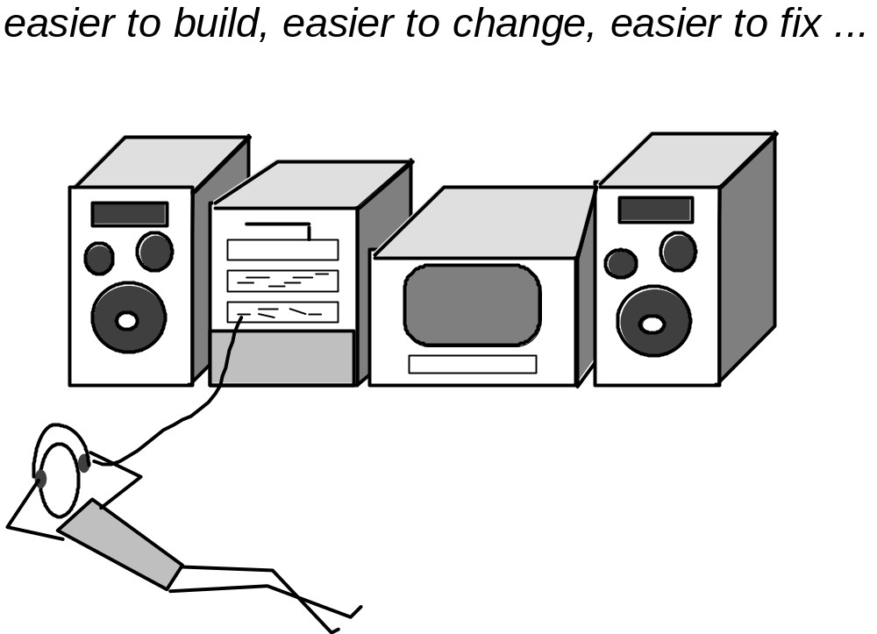
Modular Design
abstraction
architecture
modularity
functional independence
hiding
refinement
refactoring
These courseware materials are to be used in conjunction with Software Engineering: A Practitioner’s Approach, 6/e and are provided with permission by R.S. Pressman & Associates, Inc., copyright © 1996, 2001, 2005

Slide 10
Modularity: Trade-offs
What is the "right" number of modules
for a specific software design?
module development cost
cost of
software
module
integration
cost
optimal number
number of modules
of modules
These courseware materials are to be used in conjunction with Software Engineering: A Practitioner’s Approach, 6/e and are provided with permission by R.S. Pressman & Associates, Inc., copyright © 1996, 2001, 2005

Slide 11
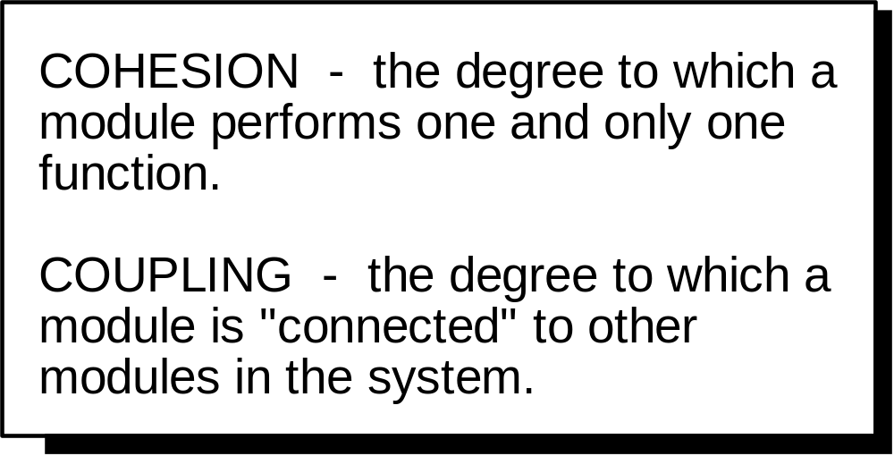
Functional Independence
abstraction
architecture
modularity
functional independence
hiding
refinement
refactoring
These courseware materials are to be used in conjunction with Software Engineering: A Practitioner’s Approach, 6/e and are provided with permission by R.S. Pressman & Associates, Inc., copyright © 1996, 2001, 2005

Slide 12
Information Hiding
abstraction
architecture
modularity
functional independence
hiding
refinement
refactoring
module
• algorithm
controlled
interface
• data structure
• details of external interface
• resource allocation policy
clients
"secret"
a specific design decision
These courseware materials are to be used in conjunction with Software Engineering: A Practitioner’s Approach, 6/e and are provided with permission by R.S. Pressman & Associates, Inc., copyright © 1996, 2001, 2005

Slide 13
Why Information Hiding?
reduces the likelihood of “side effects”
limits the global impact of local design decisions
emphasizes communication through controlled interfaces
discourages the use of global data
leads to encapsulation—an attribute of high quality design
results in higher quality software
These courseware materials are to be used in conjunction with Software Engineering: A Practitioner’s Approach, 6/e and are provided with permission by R.S. Pressman & Associates, Inc., copyright © 1996, 2001, 2005

Slide 14
Stepwise Refinement
abstraction
architecture
modularity
functional independence
hiding
refinement
refactoring
open
walk to door;
reach for knob;
open door;
repeat until door opens
turn knob clockwise;
walk through;
if knob doesn't turn, then
close door.
take key out;
find correct key;
insert in lock;
endif
pull/push door
move out of way;
end repeat
These courseware materials are to be used in conjunction with Software Engineering: A Practitioner’s Approach, 6/e and are provided with permission by R.S. Pressman & Associates, Inc., copyright © 1996, 2001, 2005

Slide 15
Refactoring
abstraction
architecture
modularity
functional independence
hiding
refinement
refactoring
Fowler [FOW99] defines refactoring in the following manner:
  "Refactoring is the process of changing a software system in such a way that it does not alter the external behavior of the code [design] yet improves its internal structure.”
When software is refactored, the existing design is examined for
  redundancy
  unused design elements
  inefficient or unnecessary algorithms
  poorly constructed or inappropriate data structures
  or any other design failure that can be corrected to yield a better design.
These courseware materials are to be used in conjunction with Software Engineering: A Practitioner’s Approach, 6/e and are provided with permission by R.S. Pressman & Associates, Inc., copyright © 1996, 2001, 2005

Slide 16
OO Design Concepts
Design classes
  Entity classes
  Boundary classes
  Controller classes
Inheritance—all responsibilities of a superclass is immediately inherited by all subclasses
Messages—stimulate some behavior to occur in the receiving object
Polymorphism—a characteristic that greatly reduces the effort required to extend the design
These courseware materials are to be used in conjunction with Software Engineering: A Practitioner’s Approach, 6/e and are provided with permission by R.S. Pressman & Associates, Inc., copyright © 1996, 2001, 2005

Slide 17
Design Classes
Design classes
Inheritance
Messages
Polymorphism
Analysis classes are refined during design to become entity classes
Boundary classes are developed during design to create the interface (e.g., interactive screen or printed reports) that the user sees and interacts with as the software is used.
  Boundary classes are designed with the responsibility of managing the way entity objects are represented to users.
Controller classes are designed to manage
  the creation or update of entity objects;
  the instantiation of boundary objects as they obtain information from entity objects;
  complex communication between sets of objects;
  validation of data communicated between objects or between the user and the application.
These courseware materials are to be used in conjunction with Software Engineering: A Practitioner’s Approach, 6/e and are provided with permission by R.S. Pressman & Associates, Inc., copyright © 1996, 2001, 2005

Slide 18
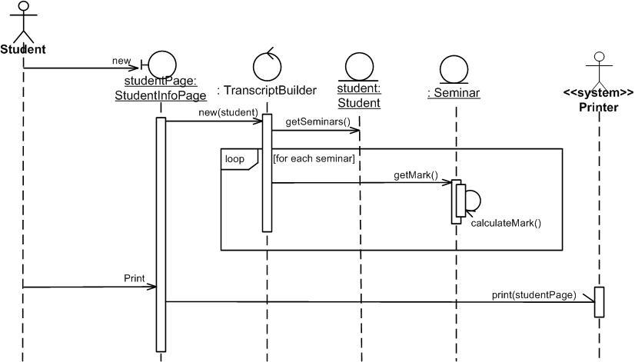
What can be in the top boxes?
(http://www.agilemodeling.com/artifacts/sequenceDiagram.htm)
Outputting transcripts
Boundary/interface elements: software elements such as screens, reports, HTML pages, or system interfaces that actors interact with.
Control/process elements (controllers): These serve as the glue between boundary elements and entity elements, implementing the logic required to manage the various elements and their interactions. Often implemented using objects, but simple ones using methods of an entity or boundary class.
Entity elements
These courseware materials are to be used in conjunction with Software Engineering: A Practitioner’s Approach, 6/e and are provided with permission by R.S. Pressman & Associates, Inc., copyright © 1996, 2001, 2005

Slide 19
Inheritance
Design classes
Inheritance
Messages
Polymorphism
Design options:
  The class can be designed and built from scratch. That is, if inheritance is not used.
  The class hierarchy can be searched to determine if a class higher in the hierarchy (a superclass) contains most of the required attributes and operations. The new class inherits from the superclass and additions may then be added, as required.
  The class hierarchy can be restructured so that the required attributes and operations can be inherited by the new class.
  Characteristics of an existing class can be overridden and different versions of attributes or operations are implemented for the new class.
These courseware materials are to be used in conjunction with Software Engineering: A Practitioner’s Approach, 6/e and are provided with permission by R.S. Pressman & Associates, Inc., copyright © 1996, 2001, 2005

Slide 20
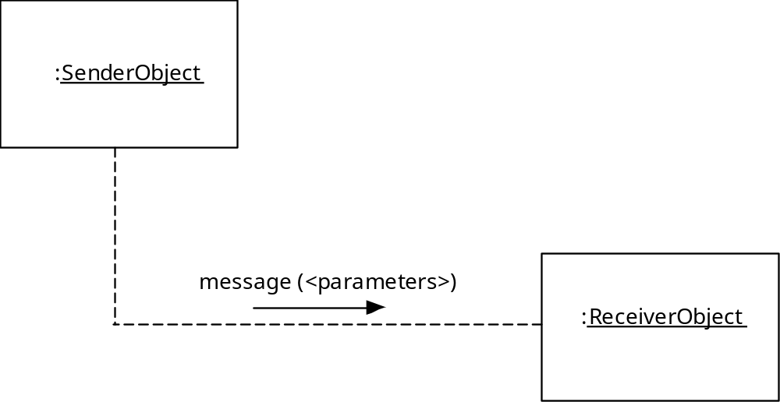
Messages
Design classes
Inheritance
Messages
Polymorphism
These courseware materials are to be used in conjunction with Software Engineering: A Practitioner’s Approach, 6/e and are provided with permission by R.S. Pressman & Associates, Inc., copyright © 1996, 2001, 2005

Slide 21
Polymorphism
Design classes
Inheritance
Messages
Polymorphism
Conventional approach …
case of graphtype:
if graphtype = linegraph then DrawLineGraph (data);
if graphtype = piechart then DrawPieChart (data);
if graphtype = histogram then DrawHisto (data);
if graphtype = kiviat then DrawKiviat (data);
end case;
All of the graphs become subclasses of a general class called graph. Using a concept called overloading [TAY90], each subclass defines an operation called draw. An object can send a draw message to any one of the objects instantiated from any one of the subclasses. The object receiving the message will invoke its own draw operation to create the appropriate graph.
graphtype draw
These courseware materials are to be used in conjunction with Software Engineering: A Practitioner’s Approach, 6/e and are provided with permission by R.S. Pressman & Associates, Inc., copyright © 1996, 2001, 2005

Slide 22
Design Model Elements
Data elements
  Data model --> data structures
  Data model --> database architecture
Architectural elements
  Application domain
  Analysis classes, their relationships, collaborations and behaviors are transformed into design realizations
  Patterns and “styles” (Chapter 10)
Interface elements
  the user interface (UI)
  external interfaces to other systems, devices, networks or other producers or consumers of information
  internal interfaces between various design components.
Component elements
Deployment elements
These courseware materials are to be used in conjunction with Software Engineering: A Practitioner’s Approach, 6/e and are provided with permission by R.S. Pressman & Associates, Inc., copyright © 1996, 2001, 2005

Slide 23
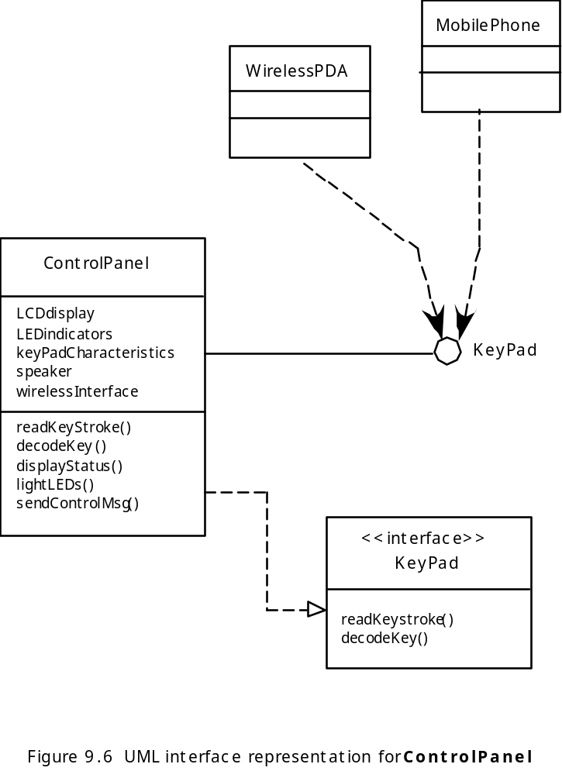
Interface Elements
These courseware materials are to be used in conjunction with Software Engineering: A Practitioner’s Approach, 6/e and are provided with permission by R.S. Pressman & Associates, Inc., copyright © 1996, 2001, 2005

Slide 24
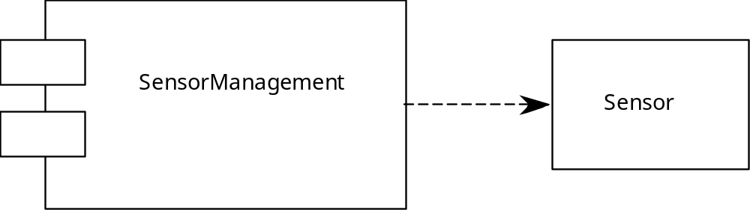
Component Elements
These courseware materials are to be used in conjunction with Software Engineering: A Practitioner’s Approach, 6/e and are provided with permission by R.S. Pressman & Associates, Inc., copyright © 1996, 2001, 2005

Slide 25
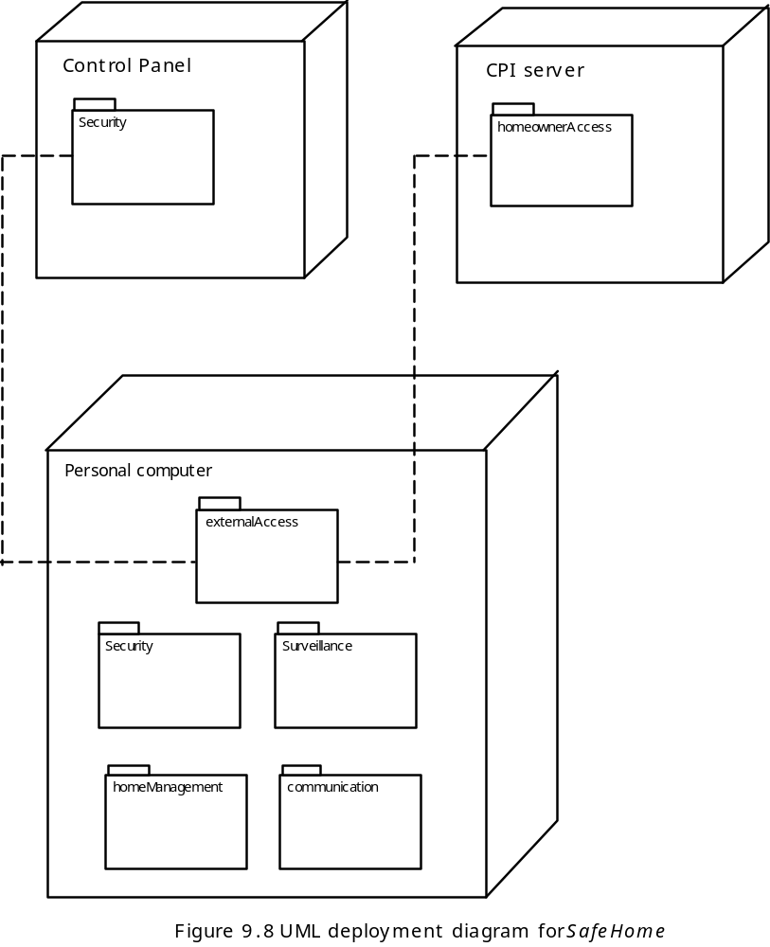
Deployment Elements
These courseware materials are to be used in conjunction with Software Engineering: A Practitioner’s Approach, 6/e and are provided with permission by R.S. Pressman & Associates, Inc., copyright © 1996, 2001, 2005

Slide 26
Patterns
Design Pattern Template
Pattern name—describes the essence of the pattern in a short but expressive name
Intent—describes the pattern and what it does
Also-known-as—lists any synonyms for the pattern
Motivation—provides an example of the problem
Applicability—notes specific design situations in which the pattern is applicable
Structure—describes the classes that are required to implement the pattern
Participants—describes the responsibilities of the classes that are required to implement the pattern
Collaborations—describes how the participants collaborate to carry out their responsibilities
Consequences—describes the “design forces” that affect the pattern and the potential trade-offs that must be considered when the pattern is implemented
Related patterns—cross-references related design patterns
These courseware materials are to be used in conjunction with Software Engineering: A Practitioner’s Approach, 6/e and are provided with permission by R.S. Pressman & Associates, Inc., copyright © 1996, 2001, 2005

Slide 27
Design Patterns
The best designers in any field have an uncanny ability to see patterns that characterize a problem and corresponding patterns that can be combined to create a solution
A description of a design pattern may also consider a set of design forces.
  Design forces describe non-functional requirements (e.g., ease of maintainability, portability) associated the software for which the pattern is to be applied.
The pattern characteristics (classes, responsibilities, and collaborations) indicate the attributes of the design that may be adjusted to enable the pattern to accommodate a variety of problems.
These courseware materials are to be used in conjunction with Software Engineering: A Practitioner’s Approach, 6/e and are provided with permission by R.S. Pressman & Associates, Inc., copyright © 1996, 2001, 2005

Slide 28
Frameworks
A framework is not an architectural pattern, but rather a skeleton with a collection of “plug points” (also called hooks and slots) that enable it to be adapted to a specific problem domain.
Gamma et al note that:
  Design patterns are more abstract than frameworks.
  Design patterns are smaller architectural elements than frameworks
  Design patterns are less specialized than frameworks
These courseware materials are to be used in conjunction with Software Engineering: A Practitioner’s Approach, 6/e and are provided with permission by R.S. Pressman & Associates, Inc., copyright © 1996, 2001, 2005

Slide 29

The Design Model
These courseware materials are to be used in conjunction with Software Engineering: A Practitioner’s Approach, 6/e and are provided with permission by R.S. Pressman & Associates, Inc., copyright © 1996, 2001, 2005

